Slide 1
Collaborative Development using Git(Hub)
Workshop
5th of July

Slide 2
Contents
Version control systems
Concepts: repository, Git, GitHub
Master-branch
Git clone, commit, push, and pull
How to do it
Best practices

Slide 3
About Version Control
Version control is a system that records changes to a file or set of files over time so that you can
recall specific versions later
revert selected files back to a previous state
revert the entire project back to a previous state
compare changes over time
see who last modified something that might be causing a problem, who introduced an issue and when
If you screw things up or lose files, you can easily recover

Slide 4
Local Version Control
Local VCSs with a simple database that keeps all the changes to files under revision control.
Works by keeping patch sets (that is, the differences between files) in a special format on disk
It can then re-create what any file looked like at any point in time by adding up all the patches.
They need to collaborate with developers on other systems
Normal v1, v2, … stored in your computer

Slide 5
Centralised Version Control
Single server that contains all the versioned files, with a number of clients that check out files from that central place
Everyone knows what everyone else on the project is doing
Easier to administer than it is to deal with local databases on every client
Single point of failure
Whenever you have the entire history of the project in a single place, you risk losing everything
Nutstore! (or at least the most similar)

Slide 6
Distributed Version Control
Local copy fully mirror the repository, including its full history
Deal pretty well with having several remote repositories they can work with
Can collaborate with different groups of people in different ways simultaneously within the same project
Git does this!

Slide 7
GitHub, main concepts
Git: Opensource version control technology. You can have your own Git server that uses Git technology, or use a third party Git Server.
GitHub: Git server and platform that offer free and premium Git services, such as storing of your repositories.
Repository: your program. It includes EVERYTHING it needs to run, can also include references, archive. MUST include readme and version log.
Advantages of Git (or GitHub):
Version control, can access any version in the past
Safety –Storage on cloud
Collaborative coding, reducing unnecessary communication

Slide 8
Master – Branch structure
Master
Stable code that goes to production

Slide 9
Master – Branch structure
Master
Stable code that goes to production
Dev
Code that centralises all the new developments

Slide 10
Master – Branch structure
Master
Stable code that goes to production
Dev
Code that centralises all the new developments
Dev - Alex
Dev – Yan-Ping
Dev – Carmo
Developers’ new developments, yet to be integrated with Dev

Slide 11
Master – Branch structure
Master
Stable code that goes to production
Dev
Code that centralises all the new developments
Dev - Alex
Dev – Yan-Ping
Dev – Carmo
Developers’ new developments, yet to be integrated with Dev
Dev - Alex
Dev – Yan-Ping
Dev – Carmo
Local Development yet to be uploaded to GitHub

Slide 12
Git Actions
Dev - Alex
Pull: Get the last version of your branch
Dev - Alex
Commit: Save changes locally, save any progress
Push: Save changes online, upload any code that compiles

Slide 13
Git Actions
Merge from branch A to branch B: take the changes of A to B, keeping also the changes in B, and overwriting B
Dev
Merge
Reversal merge
Dev - Alex
Dev – Yan-Ping
Dev – Carmo
Merge from branch Dev - Alex to branch Dev : take the changes of Dev - Alex to Dev, keeping also the changes in Dev, and overwriting Dev
Reversal Merge from branch Dev to branch Dev - Carmo : take the changes of Dev to Dev - Carmo, keeping also the changes in Dev - Carmo , and overwriting Dev - Carmo

Slide 14
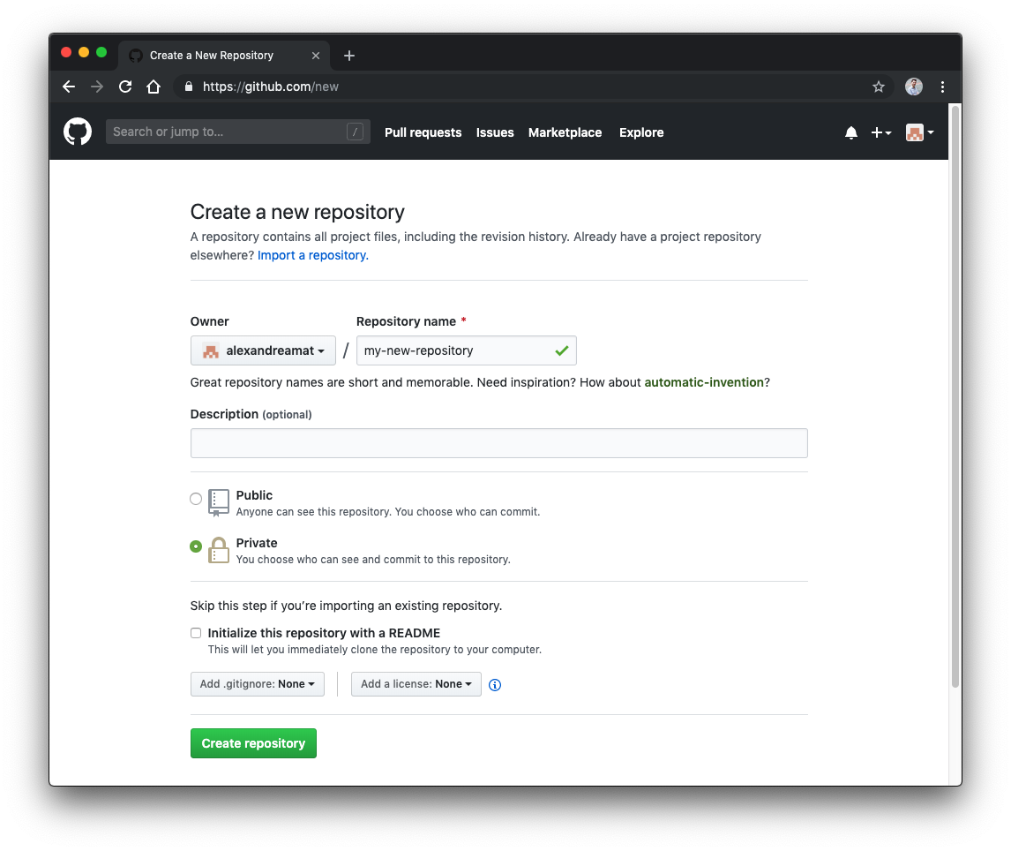
Create a repository
Name
Brief description
Make private
You are good to go

Slide 15
Create a repository
Create your local repository through Terminal (Mac) or Command Line (Windows)
Step 1: Navigate to your (new and empty) project folder using ls (Mac) or dir (Windows) and cd commands
Step 2: Start your local repository with the following commands:
echo "# my-new-repository" >> README.md
git init
git add README.md
git commit -m "first commit"
git remote add origin https://github.com/alexandreamat/my-new-repository.git
git push -u origin master
Or if you are a new collaborator of an existing project:
git clone https://github.com/alexandreamat/my-new-repository.git

Slide 16
Typical git workflow: single branch
Check the state of addition, deletion, modification, and tracking of files in the repository
git status
Add new files and modifications on existing files
git add *
Commit changes to register a new local version
git commit –m ‘explanation of changes I want to commit’
Upload changes to the git server
git push
Download changes from the git server to make sure we have the last version
git pull

Slide 17
Typical git workflow: multiple branches
Check your current working branch
git branch
Create a new branch (user_name-dev is a common convention)
git branch <new-branch-name>
Switch to the new branch as the current working branch
git checkout <new-branch-name>
Now you can git status, add, push, and pull as usual. If it is the first time you git push, you need to create the corresponding remote branch with:
git push --set-upstream origin <new-branch-name>
Merge changes from master to see if last changes in master work in your dev branch. Checkout to your branch and then:
git merge master –m ‘description of the merge’
Finally, if it works, you can merge your changes to the master, to later commit and push
git checkout master
git merge <new-branch-name> –m ‘description of the merge’

Slide 18
IMPORTANT FACTS
GitHub never deletes any files (not even the uncommitted!), it just keeps saving all the successive changes, the repository is ever-growing
Local, visible files are fully managed by Git, manual modifications do not really matter, and are discouraged
Git add + commit + push is the routine way of working in an organised, controlled, and clean fashion

Slide 19
Next meeting…
Master / branch collaboration
Git branch, checkout, clone…
Large files, ignore files…

